Slide 1


Slide 2



Festival of Economics.
1-3 October 2024
Book talks, panels & live podcast recordings – your chance to ask experts from around the world the key economic questions of our time!
Scan for tickets and the programme.
With the election of a new government after 14 years, the theme of the Festival is looking back, to look forward:
Legacies of Empire, Inequalities, The Tyranny of Nostalgia, Sustainable Futures, Labour’s first 100 days, Building a fair society, Britain’s place in the world , Social mobility, The kids aren’t alright, UK productivity, Tim Harford podcast
… and more!
FREE TICKETS for:
- Legacies of Empire (Tues 1 October, 7pm)
- Inequalities (Thursday 3 Oct, 7pm)
in the Wills Memorial Building and are free to UoB students

Slide 3

Data Science. Week 3. University of Bristol Autumn 2024

Slide 4
Office hours.
Richard. Tuesday, 14.00-15.00 (TBC)
Denes. Thursday, TBC (online)
Finn. Friday, 13.30-14.30 (online)
Josh. Thursday, 10.00-11.00 (TBC)
Notes:
TODO: add Zoom links to online office hours

Slide 5
Week 3.
Charts. The good the bad and the ugly.
What makes a great chart? And what to avoid.
Two ways to make a live chart. APIs vs GitHub data.
Practical 3. Making a chart from scratch.

Slide 6

Bad, Ugly … and Good.

Slide 7
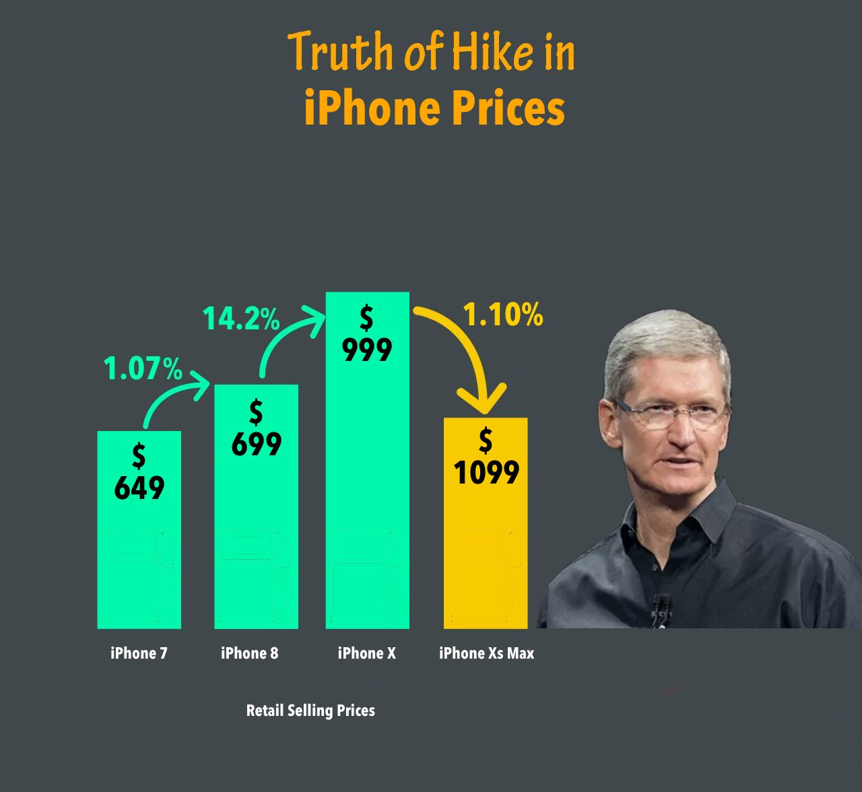
When charts go wrong.
Notes:
RS: insert example of a terrible chart

Slide 8
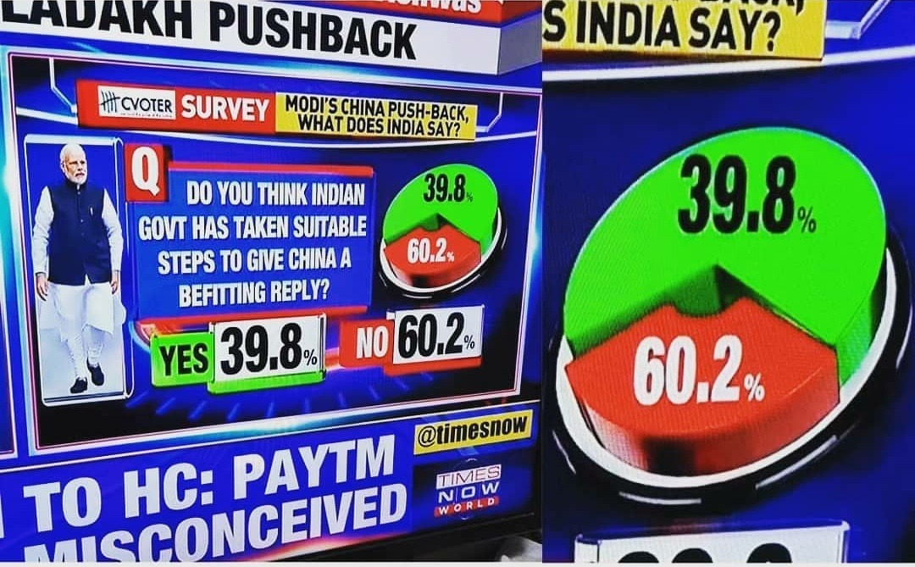
When charts go wrong.
Notes:
RS: insert example of a terrible chart

Slide 9
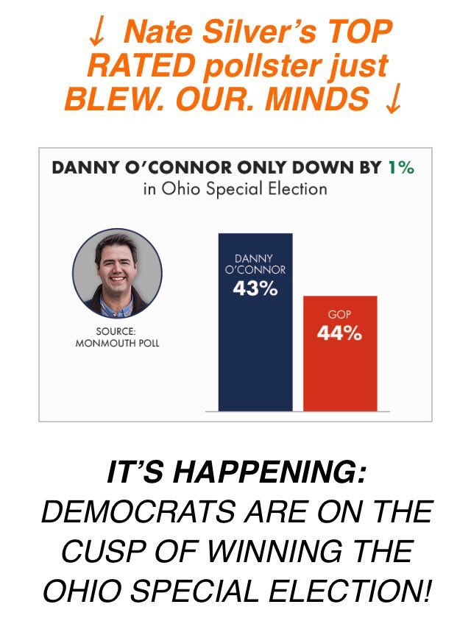
Notes:
RS: insert example of a terrible chart

Slide 10
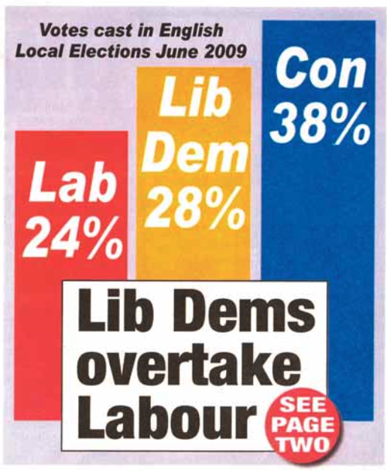
Notes:
RS: insert example of a terrible chart

Slide 11
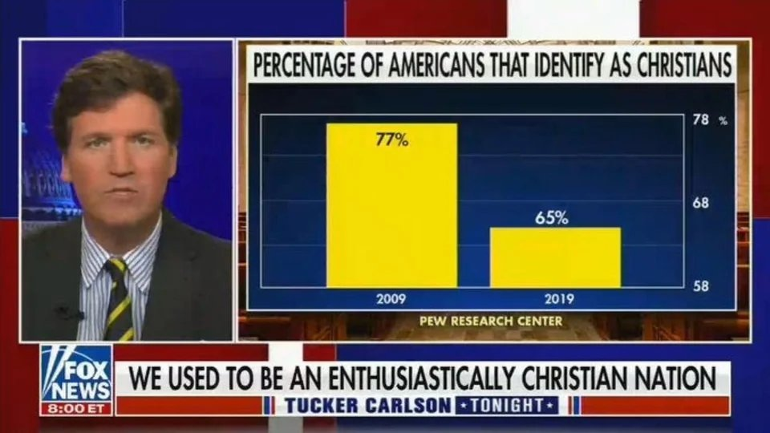
Notes:
RS: insert example of a terrible chart

Slide 12
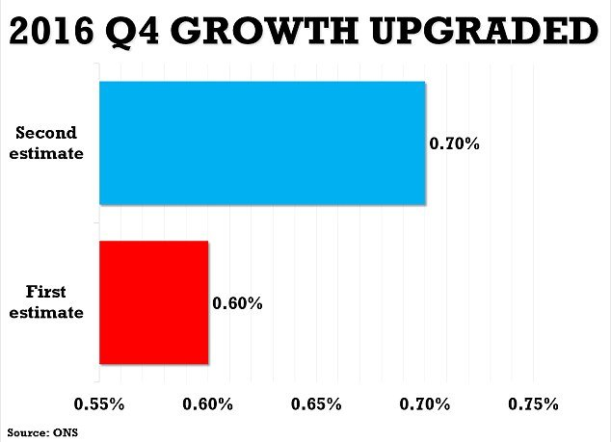
Notes:
RS: insert example of a terrible chart

Slide 13
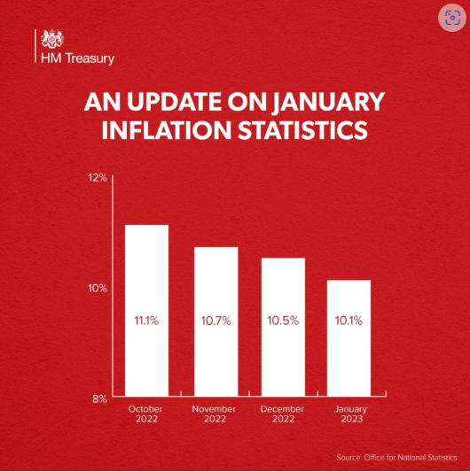
Notes:
RS: insert example of a terrible chart

Slide 14
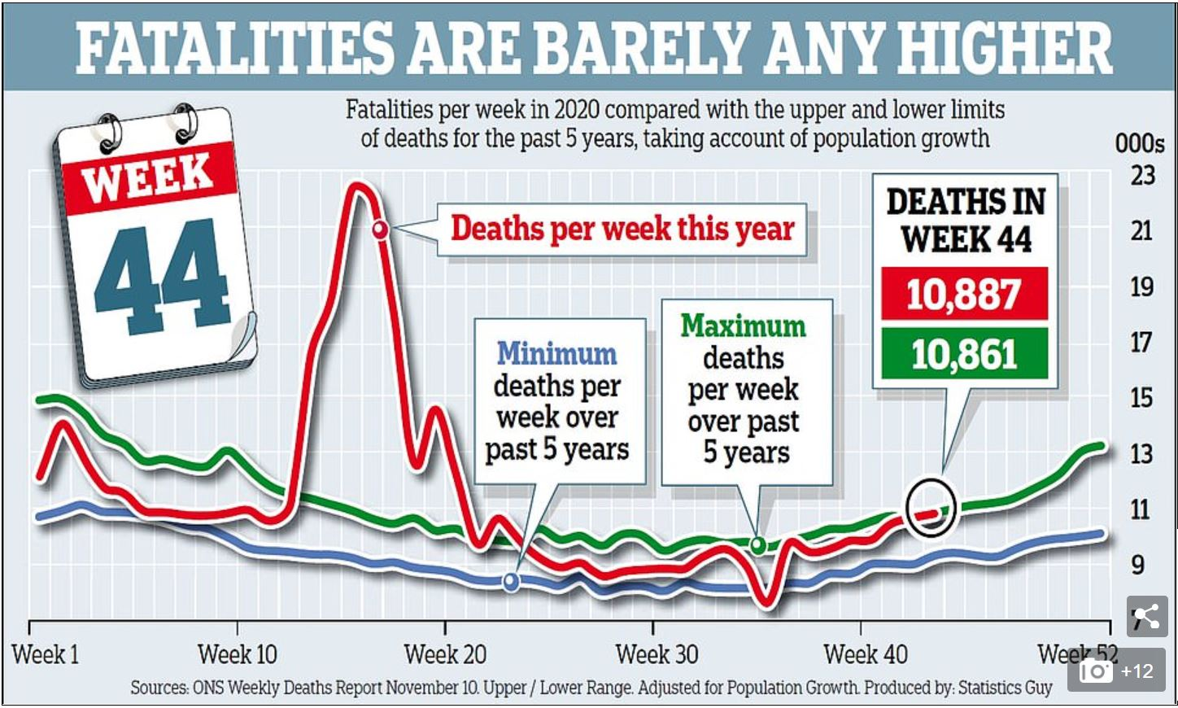
Source: Daily Mail, November 20th 2020

Slide 15

Two examples.

Slide 16
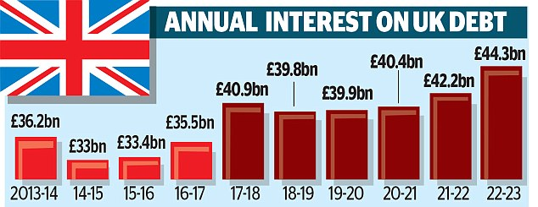
Source: Daily Mail, 2 Jan 2018

Slide 17
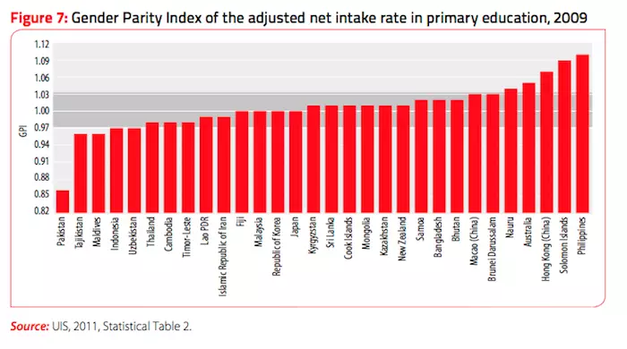

Slide 18
The same data: Different stories

Slide 19
Source: Daily Mail, 2 Jan 2018

Slide 23
Source: Daily Mail, 2 Jan 2018

Slide 24
SHARE OF NATIONAL INCOME SPENT ON UK DEBT

Slide 27
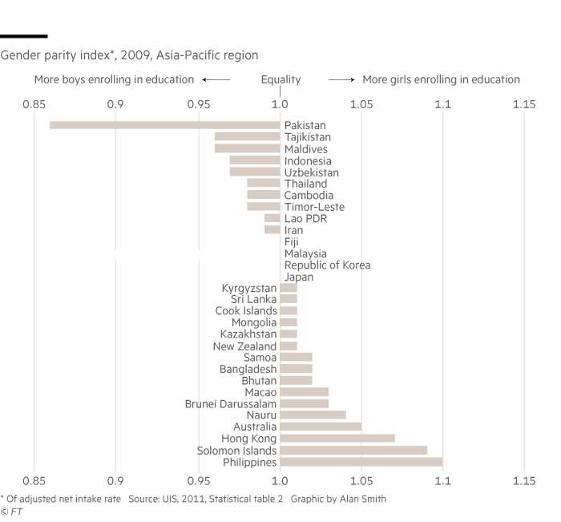

Slide 28
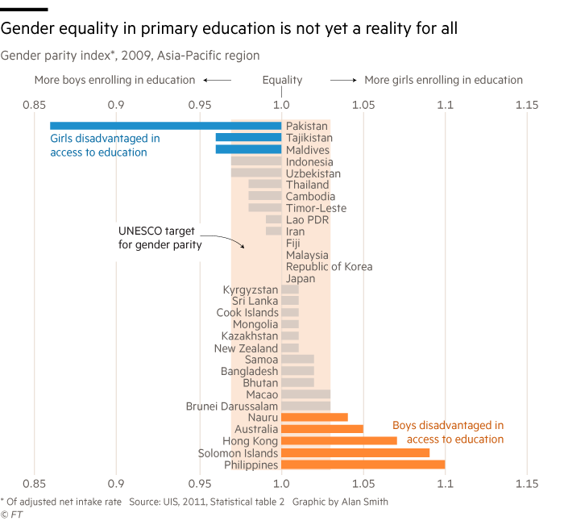

Slide 29
Chartjunk: a gallery.

Slide 30
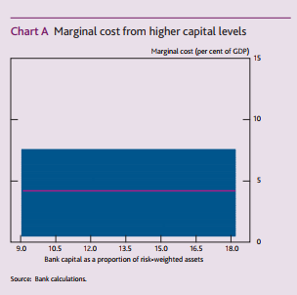

Slide 31
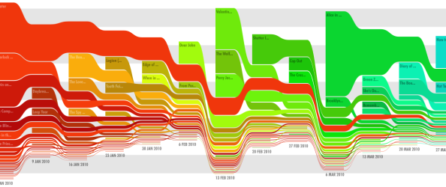

Slide 32
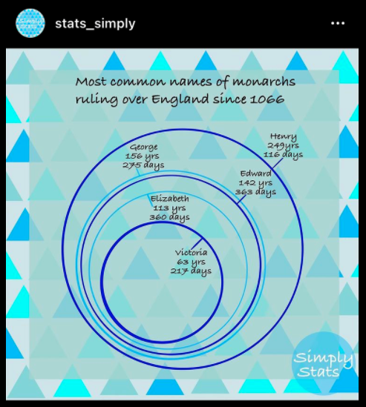
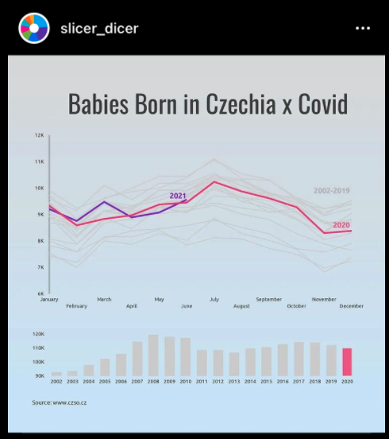
Notes:
RS: insert example of a terrible chart

Slide 33
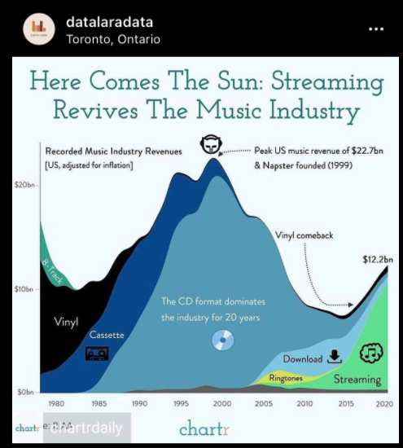
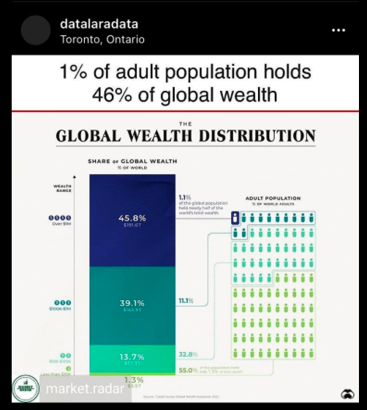
Notes:
RS: insert example of a terrible chart

Slide 34
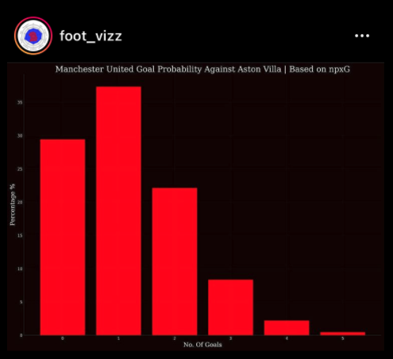
Notes:
RS: insert example of a terrible chart

Slide 35
Dataviz heroes.

Slide 36
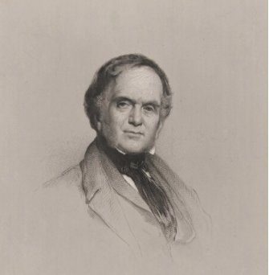
William Playfair.
Born in 1759, William Playfair invented the chart.
The Commercial and Political Atlas (1785) which featured 40 charts covering trade, debt, expenditure and other economic matters
Playfair was the first to add the vertical axis (previous charts did not have this feature, meaning the way data were stacked vertically meant nothing).
His charts were relevant to policy. Playfair made charts that demand those in charge of policy to pay attention
“Information, that is imperfectly acquired, is generally as imperfectly retained; and a man who has carefully investigated a printed table, finds, when done, that he has only a very faint and partial idea of what he has read; and that like a figure imprinted on sand, is soon totally erased and defaced.”
Notes:
RS: insert example of a terrible chart

Slide 37
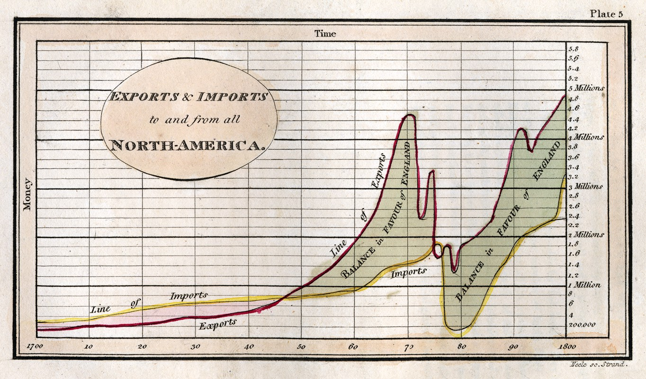
Politics and trade.

Slide 38
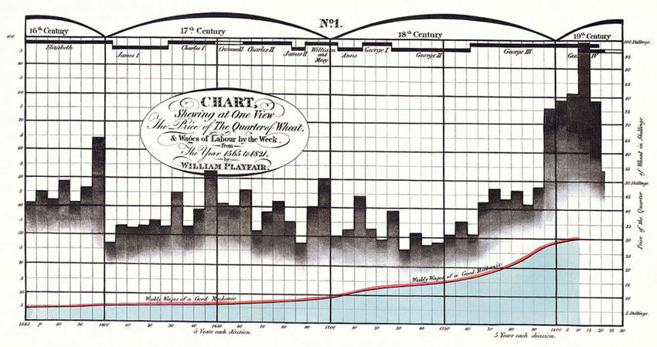
Real wages.

Slide 39
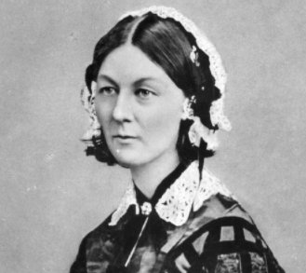
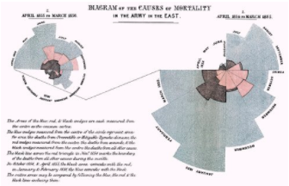
Florence Nightingale.
Born in 1820, she was a disruptor of both medicine and data
Statistician, campaigner, nurse, and inventor, she is best known as the founder of modern nursing: the lady with the lamp
After working on the frontline during the Crimean war, she decided to communicate the miserable conditions she witnessed, creating pioneering using data visualisations to make her case

Slide 40
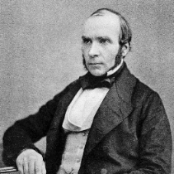
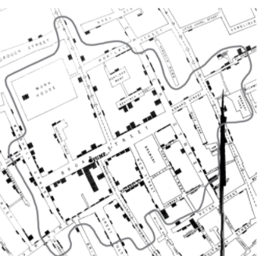
John Snow.
John Snow was an English physician
Studied 1854 cholera epidemic in London
Founding father of epidemiology, a branch of medicine that studies the contraction, spreading and control of disease.
Data pioneer, using carefully plotted maps to solve a problem that had defeated scientists of his day
Story of the Broad Street pump
Notes:
RS: insert example of a terrible chart

Slide 41

Edward Tufte.
The American statistician and graphic design theorist.
The Visual Display of Quantitative Information, April 1983
Primary message: designers didn’t have to sacrifice mathematical accuracy in the quest for elegance
“data-ink ratio” to measure the proportion of a given graphic which was simply illustration rather than a representation of data.
He questioned the “data density” of graphics. And for those graphics which his disliked most coined a new word: “chartjunk”.
Notes:
RS: insert example of a terrible chart

Slide 42
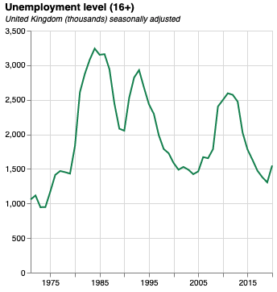
Anatomy of a good chart.
Size. The original version of this chart is 300px by 300px. This is perfect for mobile.
Y axis metric included in the title
Eye-catching colour. Make sure colours are consistent across your work
Subtitle including extra detail (such as units)
Y axis label not needed because of title
X axis label not needed because, in most cases, time is obvious
Quantitative data should start from zero by default
Notes:
RS: insert example of a terrible chart

Slide 43
A design classic.

Slide 44
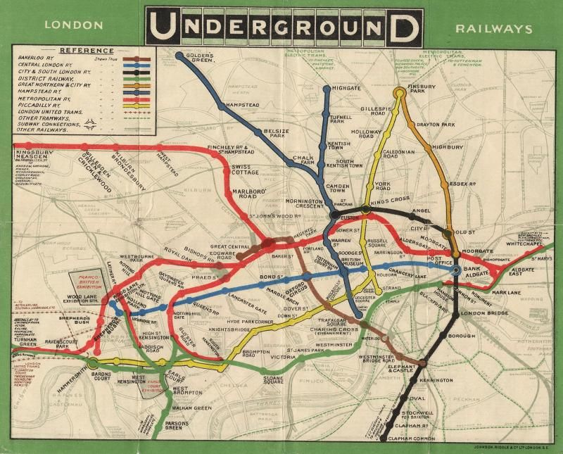
Notes:
RS: insert example of a terrible chart

Slide 45
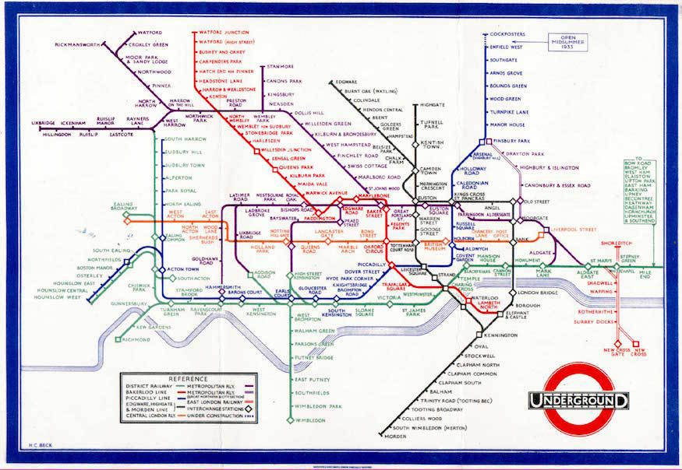
Notes:
RS: insert example of a terrible chart

Slide 46
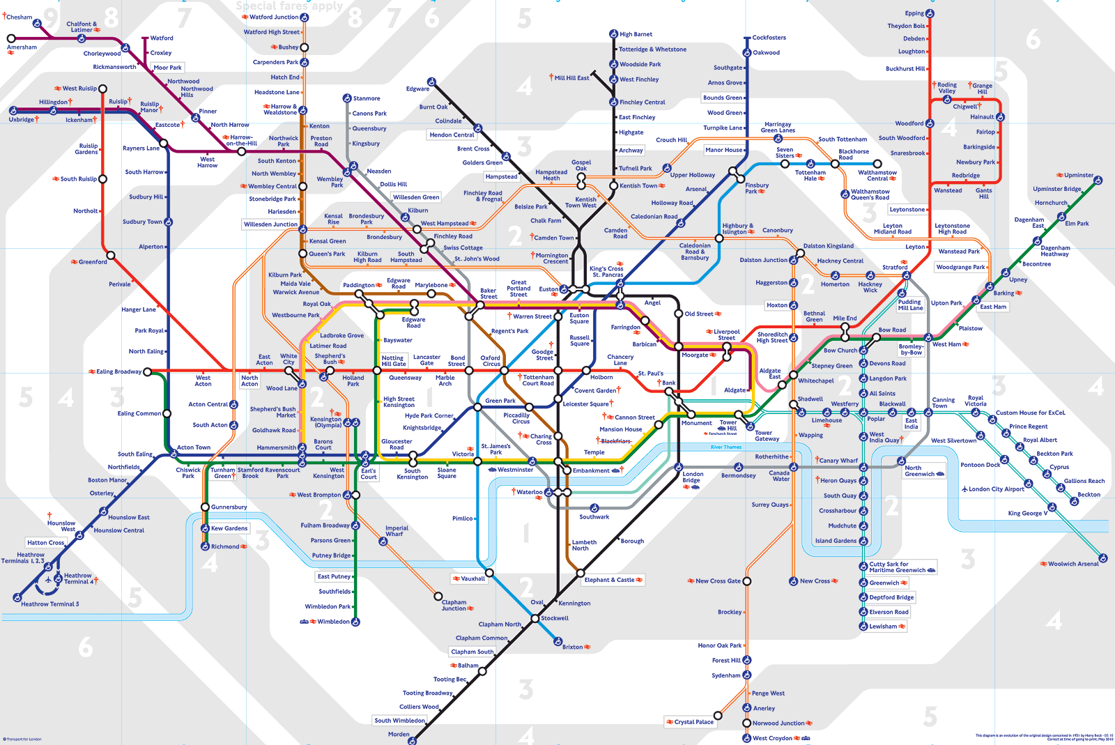
Notes:
RS: insert example of a terrible chart

Slide 47
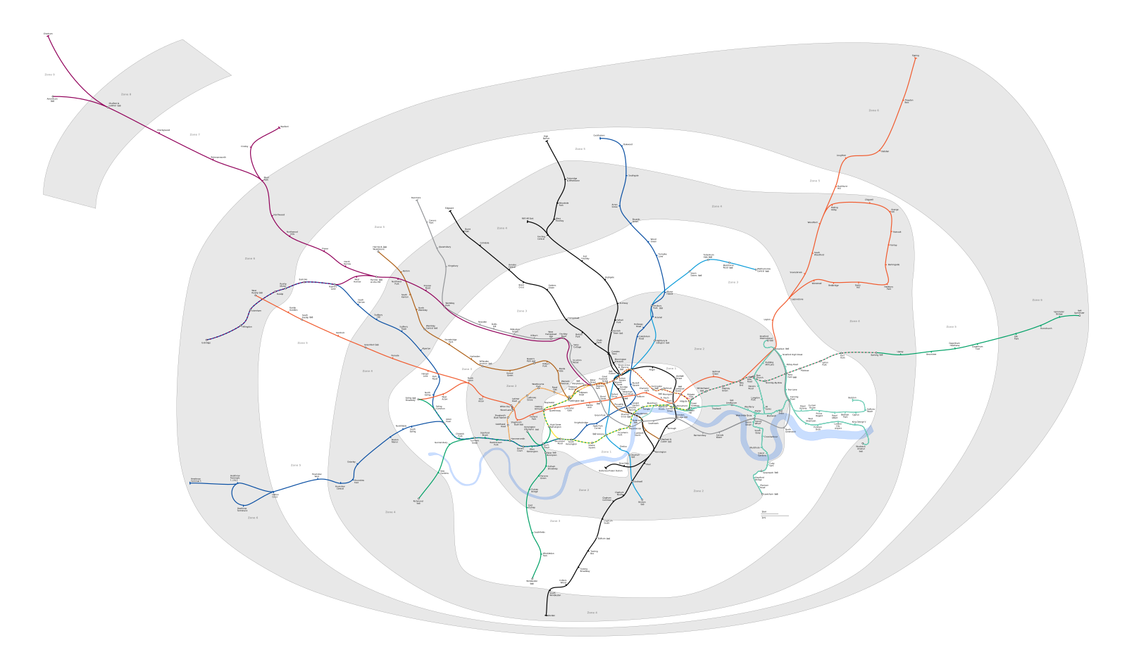
Notes:
RS: insert example of a terrible chart

Slide 49
Practical 3.
From data to a chart
Finding the dataset
Transforming the series
Uploading the data
Adapting a Vega-lite example
Presenting your chart

Slide 50
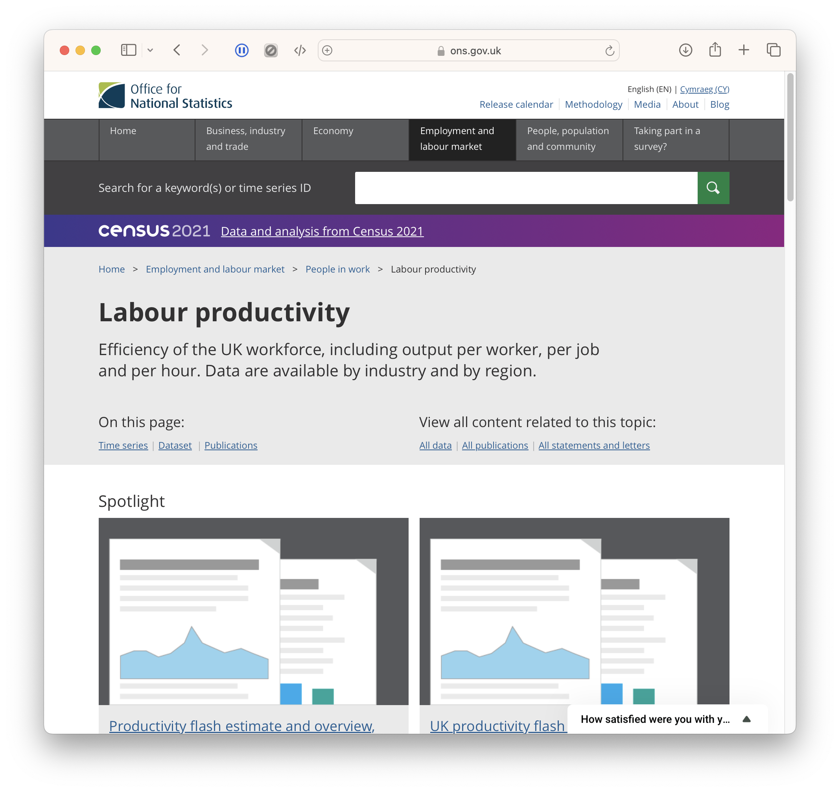
Finding data.
Let’s chart UK productivity.
This data is available from the ONS.

Slide 51
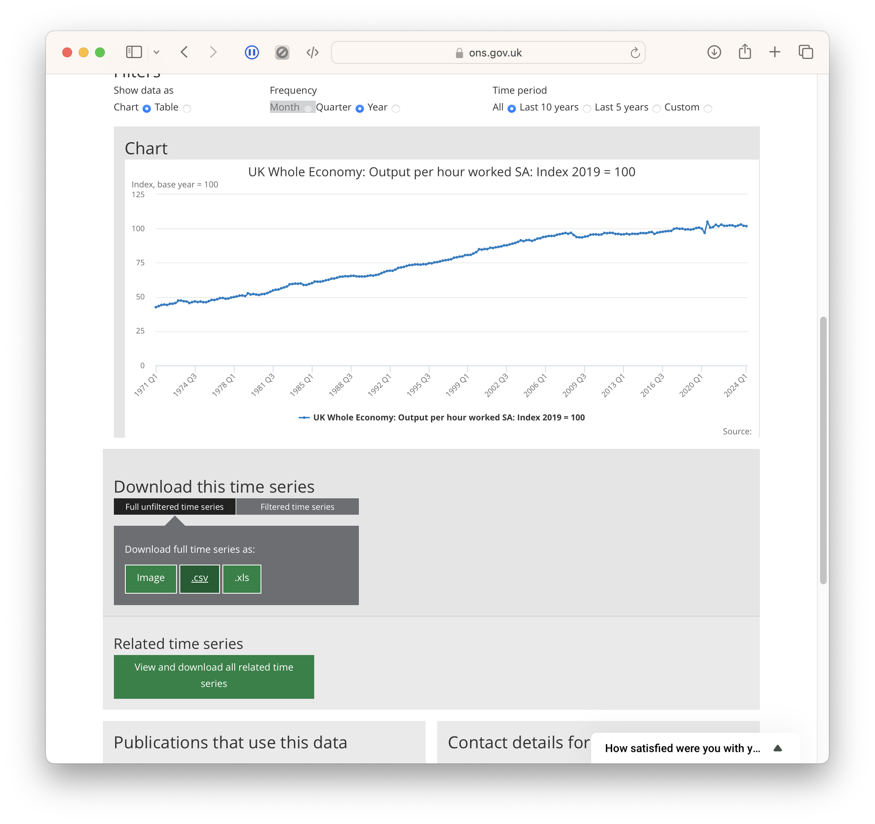
Finding data.
We need to download the CSV.

Slide 52
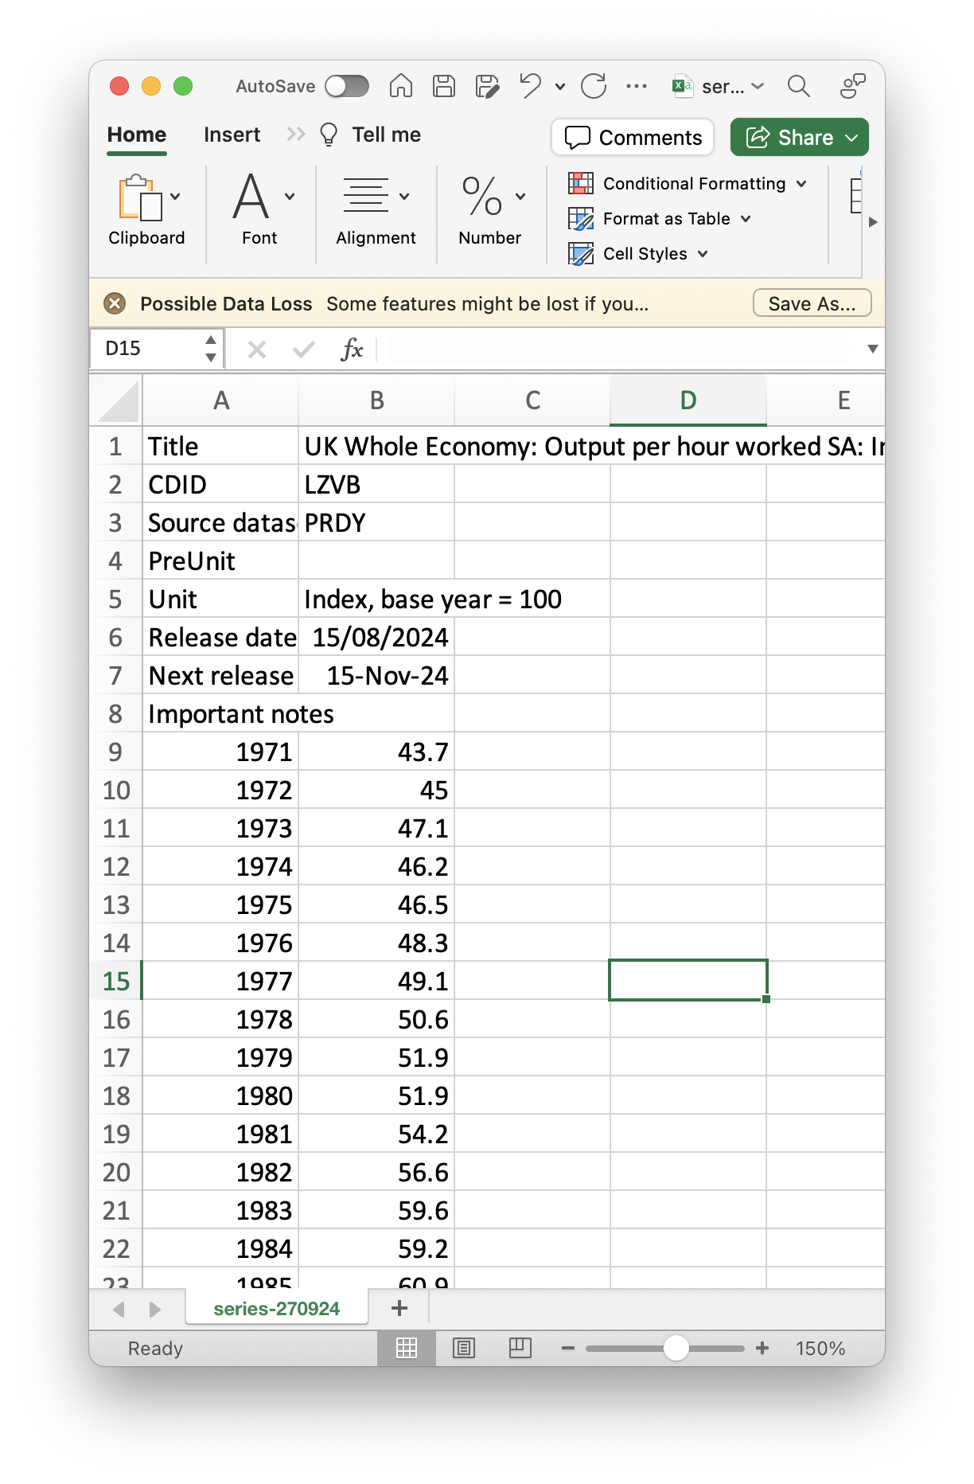
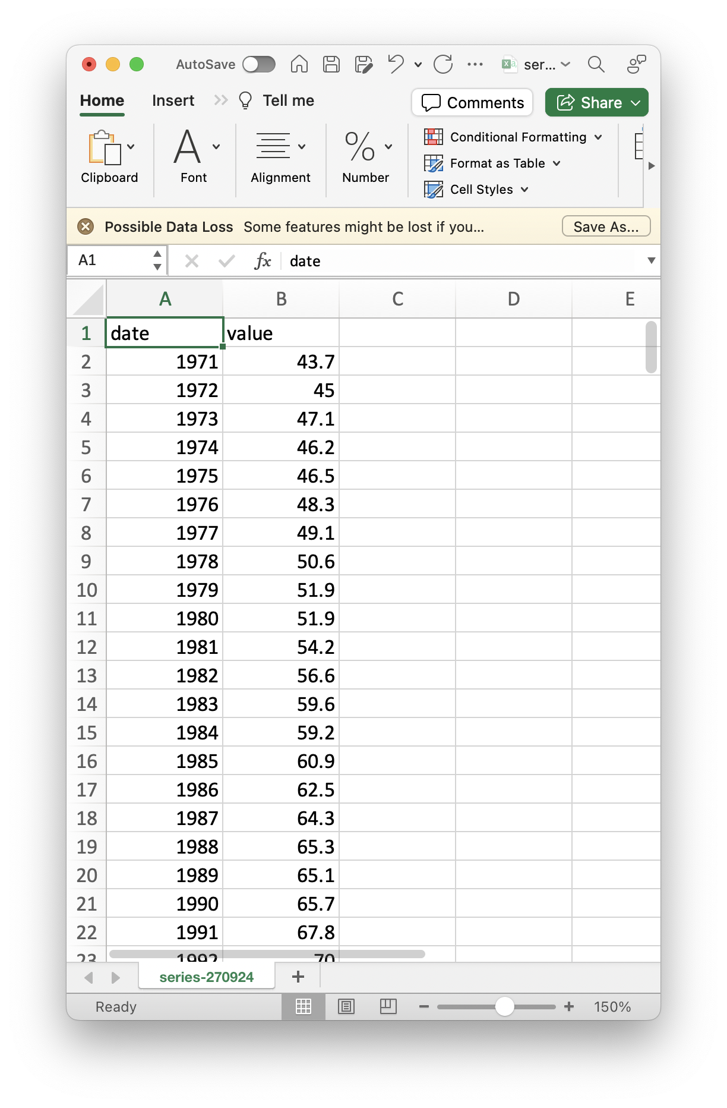
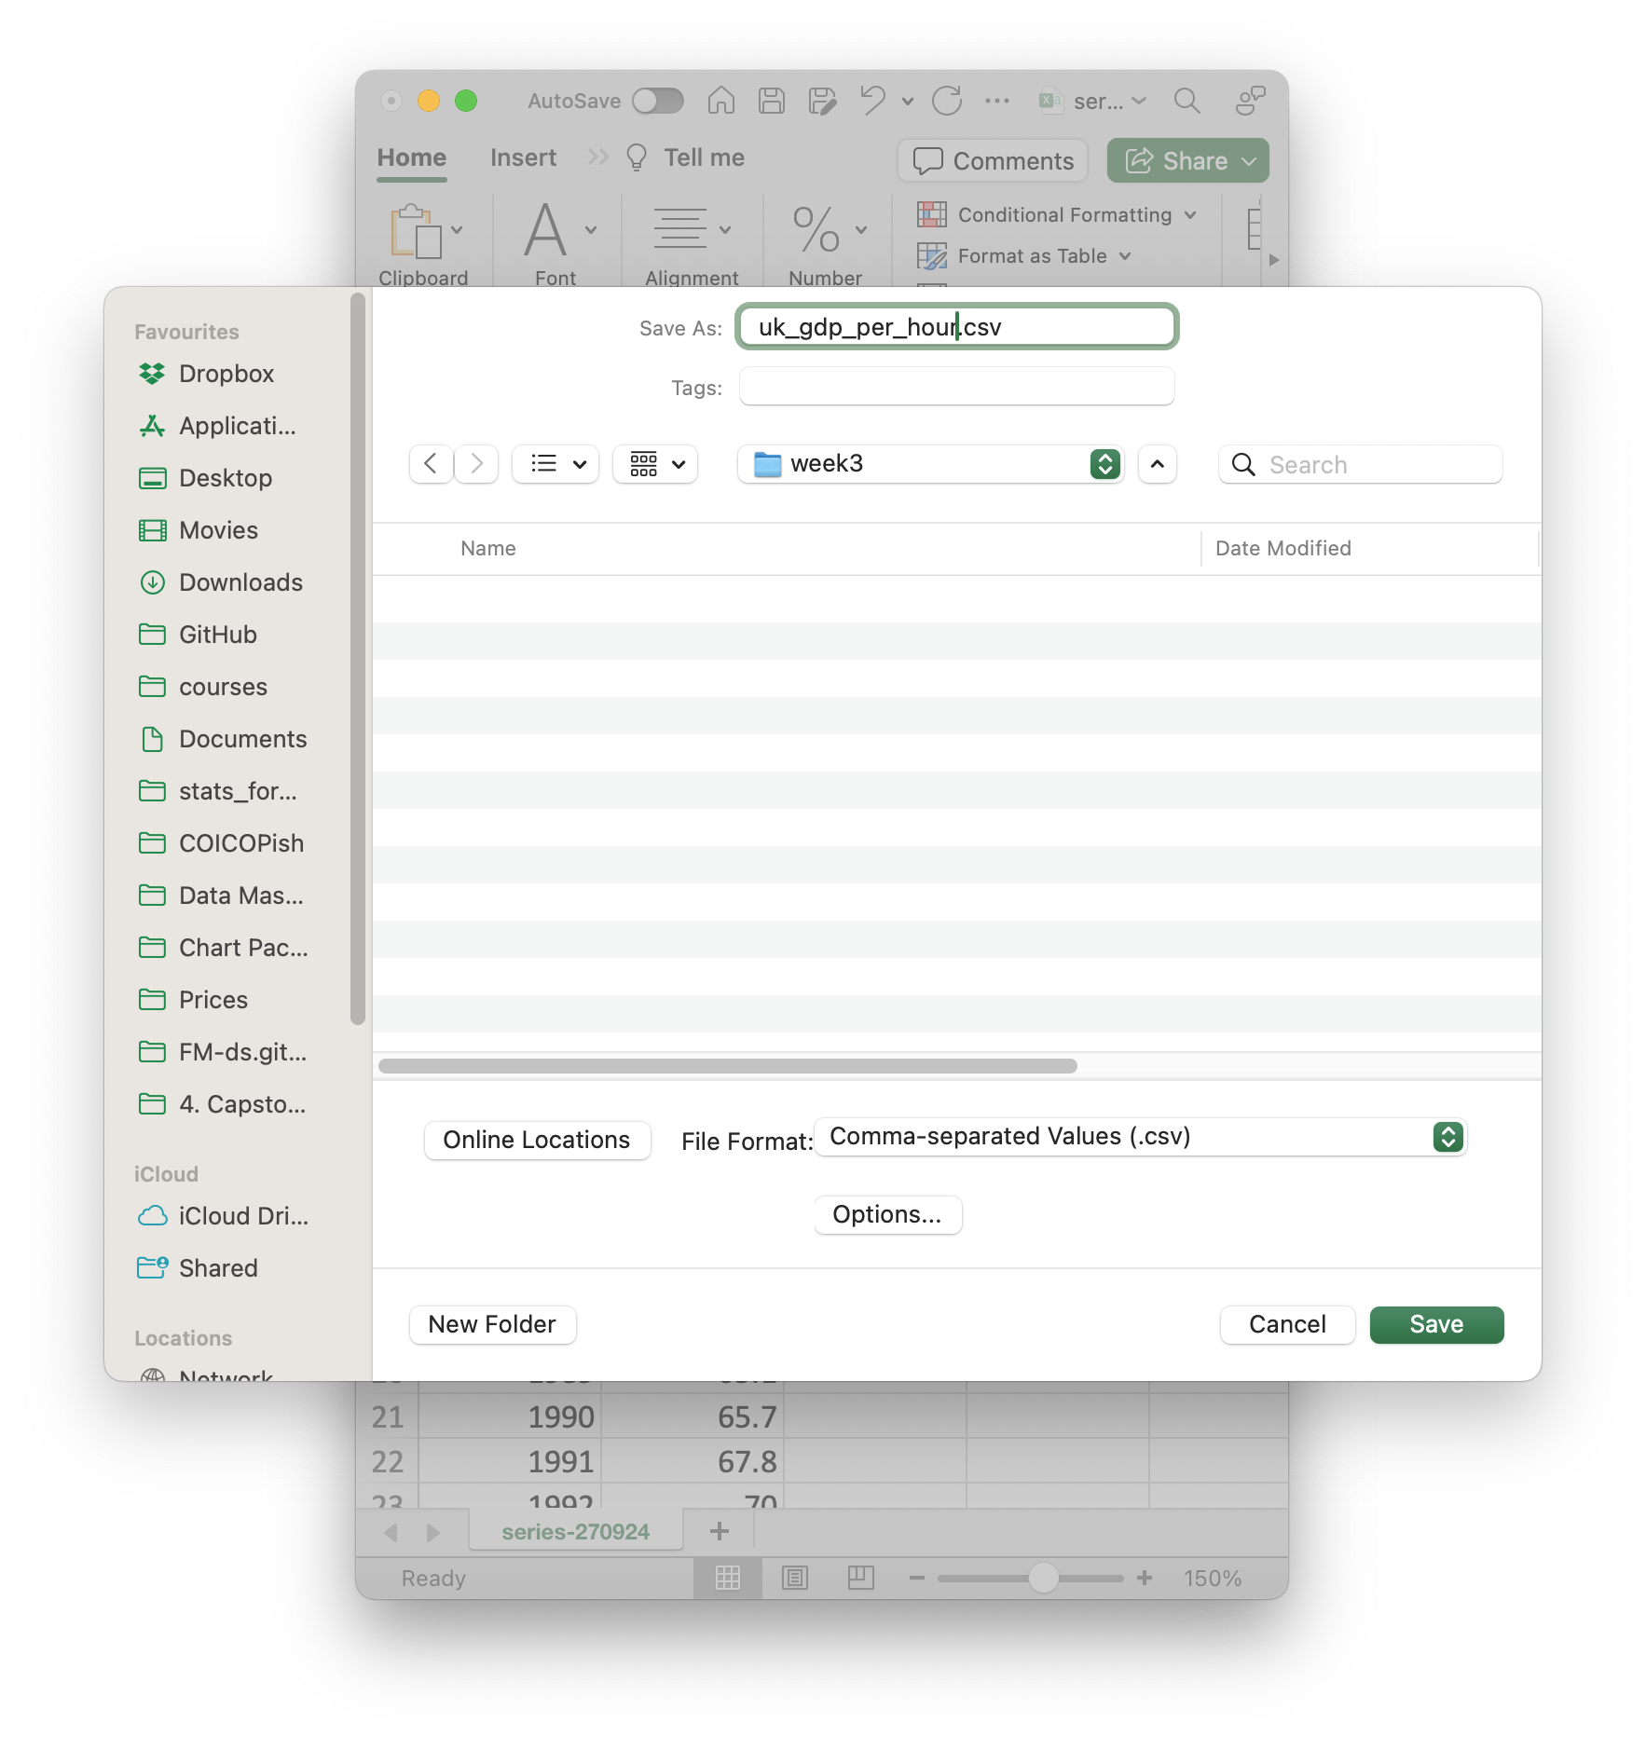
Transforming data.
Standardising column names.
And saving our output.
Is there a better way of doing this?

Slide 53
Transforming data.
Standardising column names.
And saving our output.
Is there a better way of doing this?

Slide 54
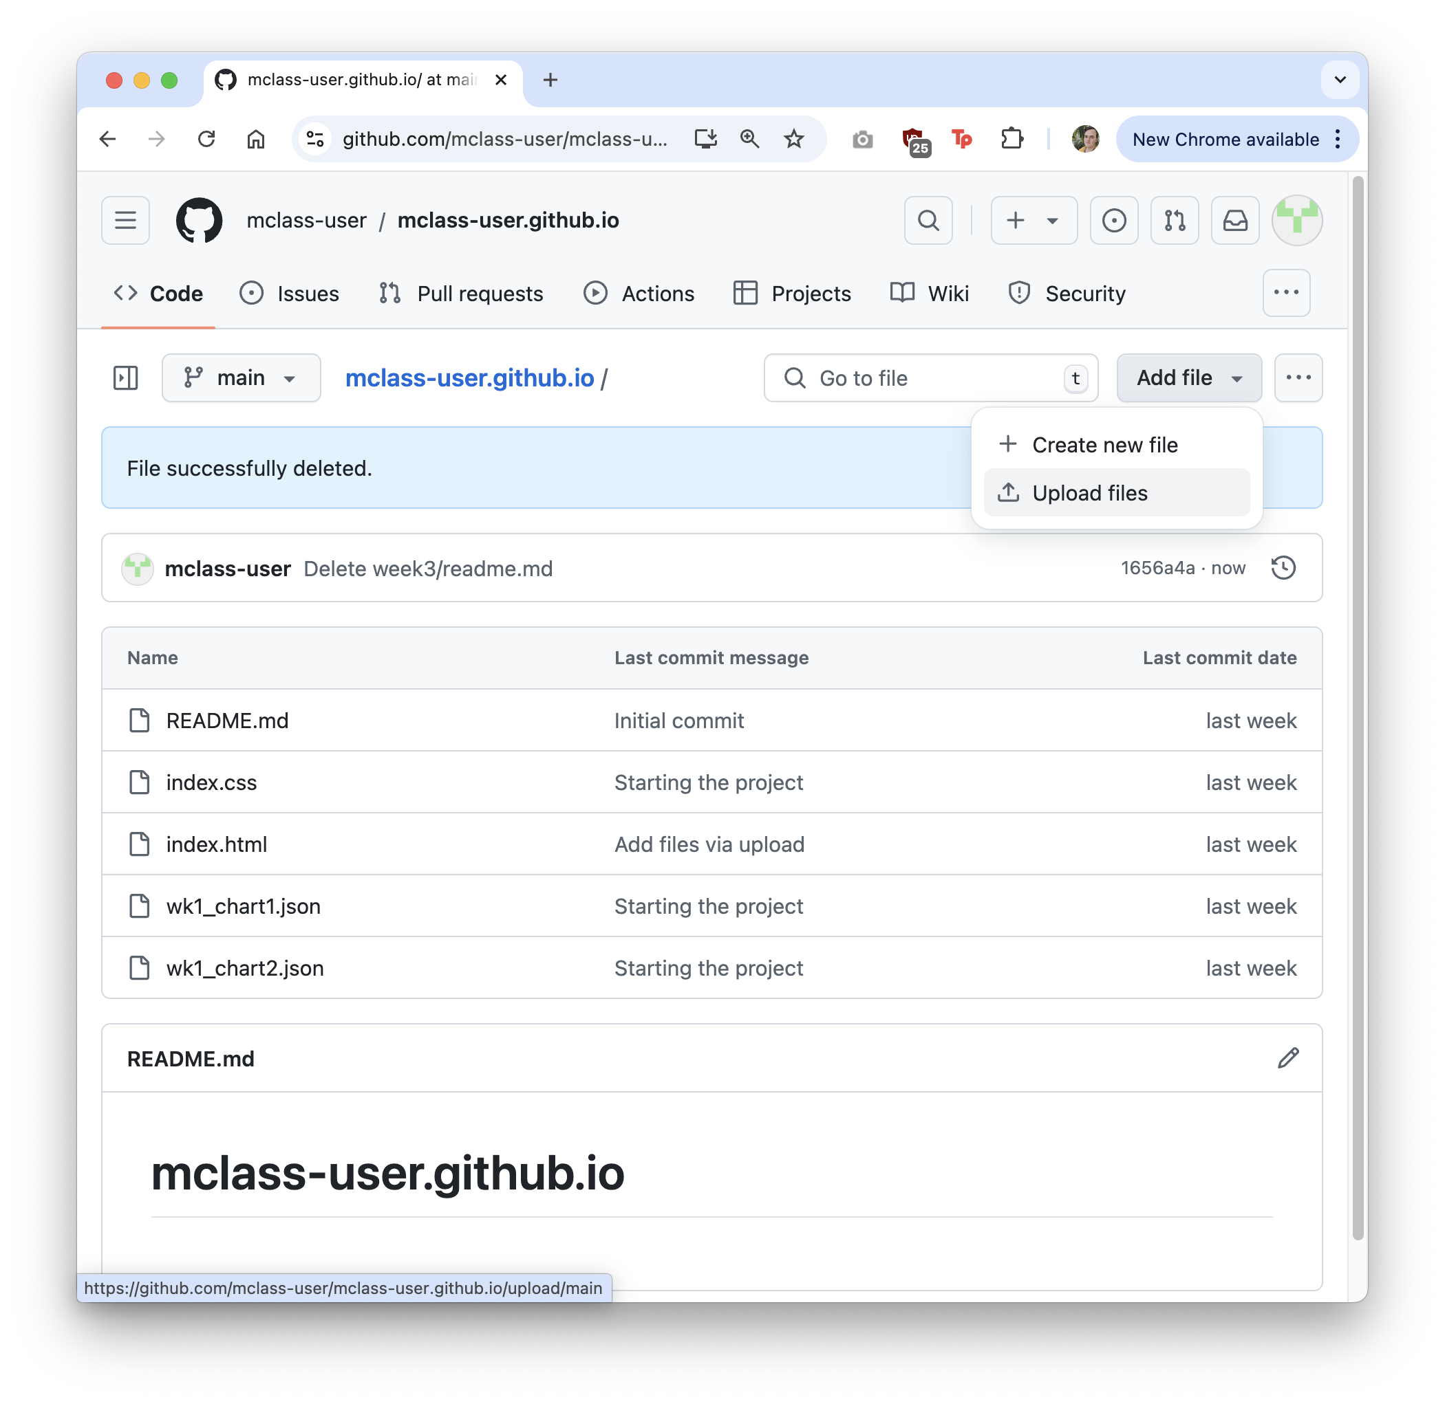
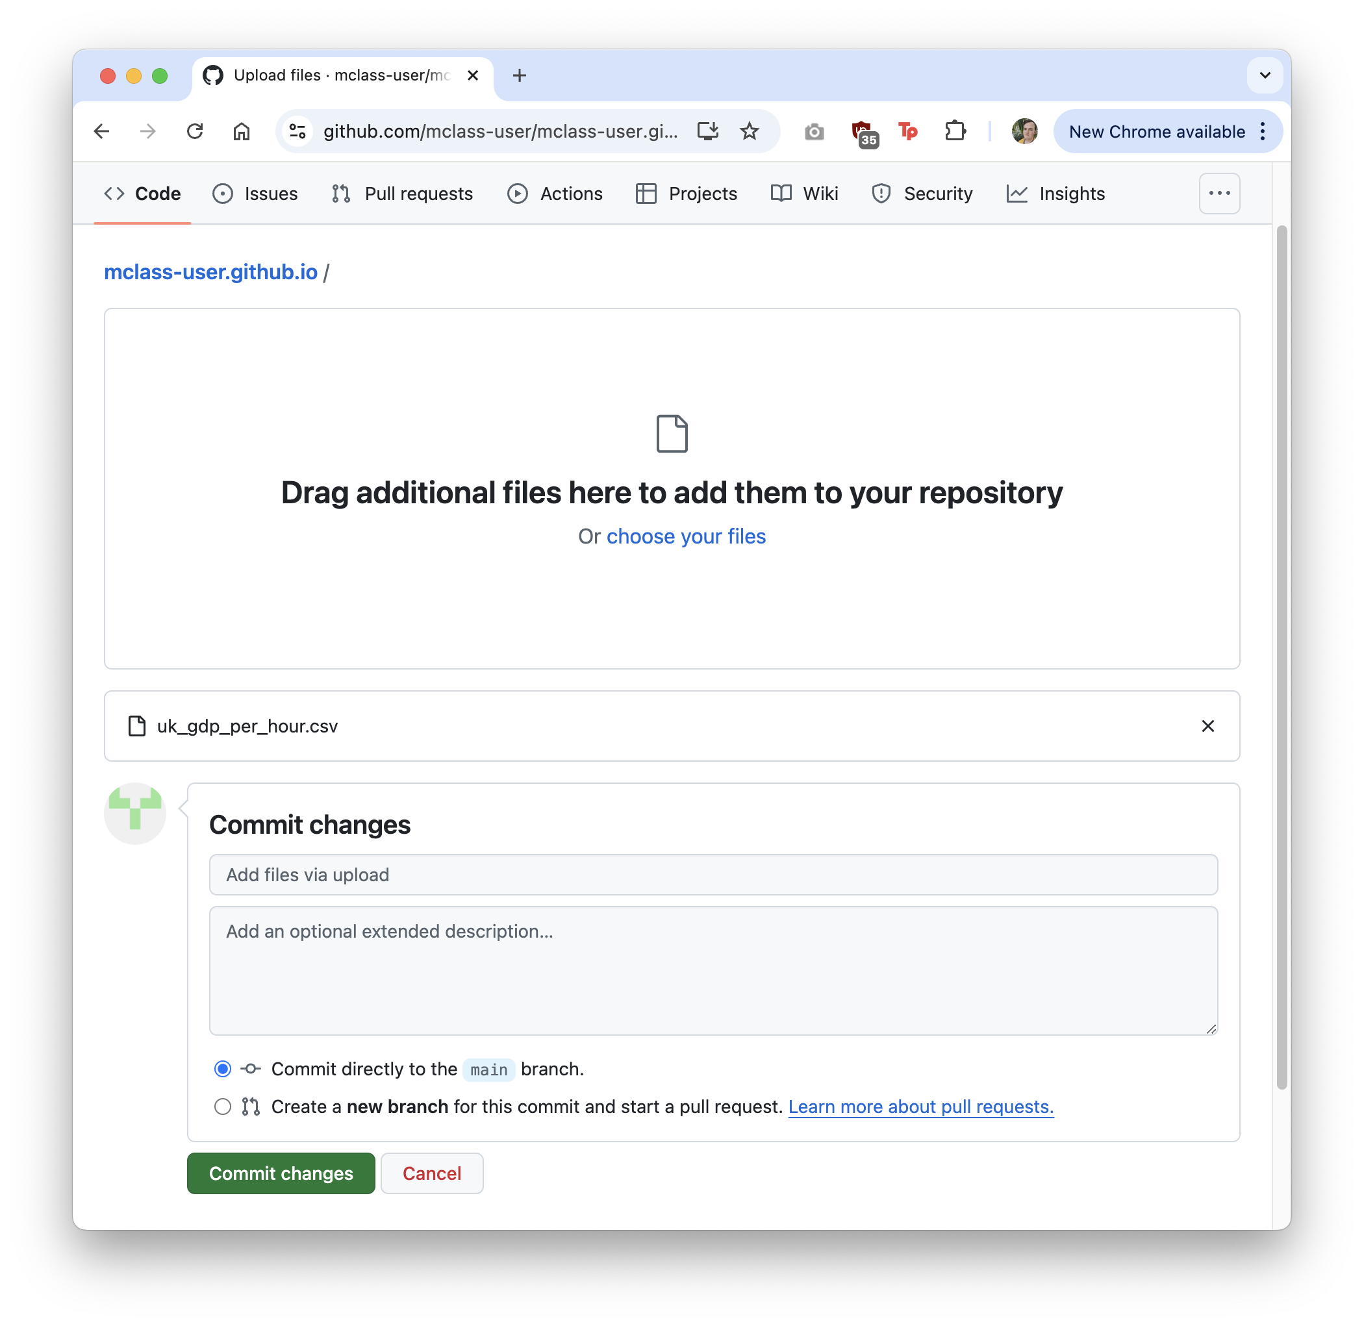
Uploading data.
Uploading the cleaned data.

Slide 55
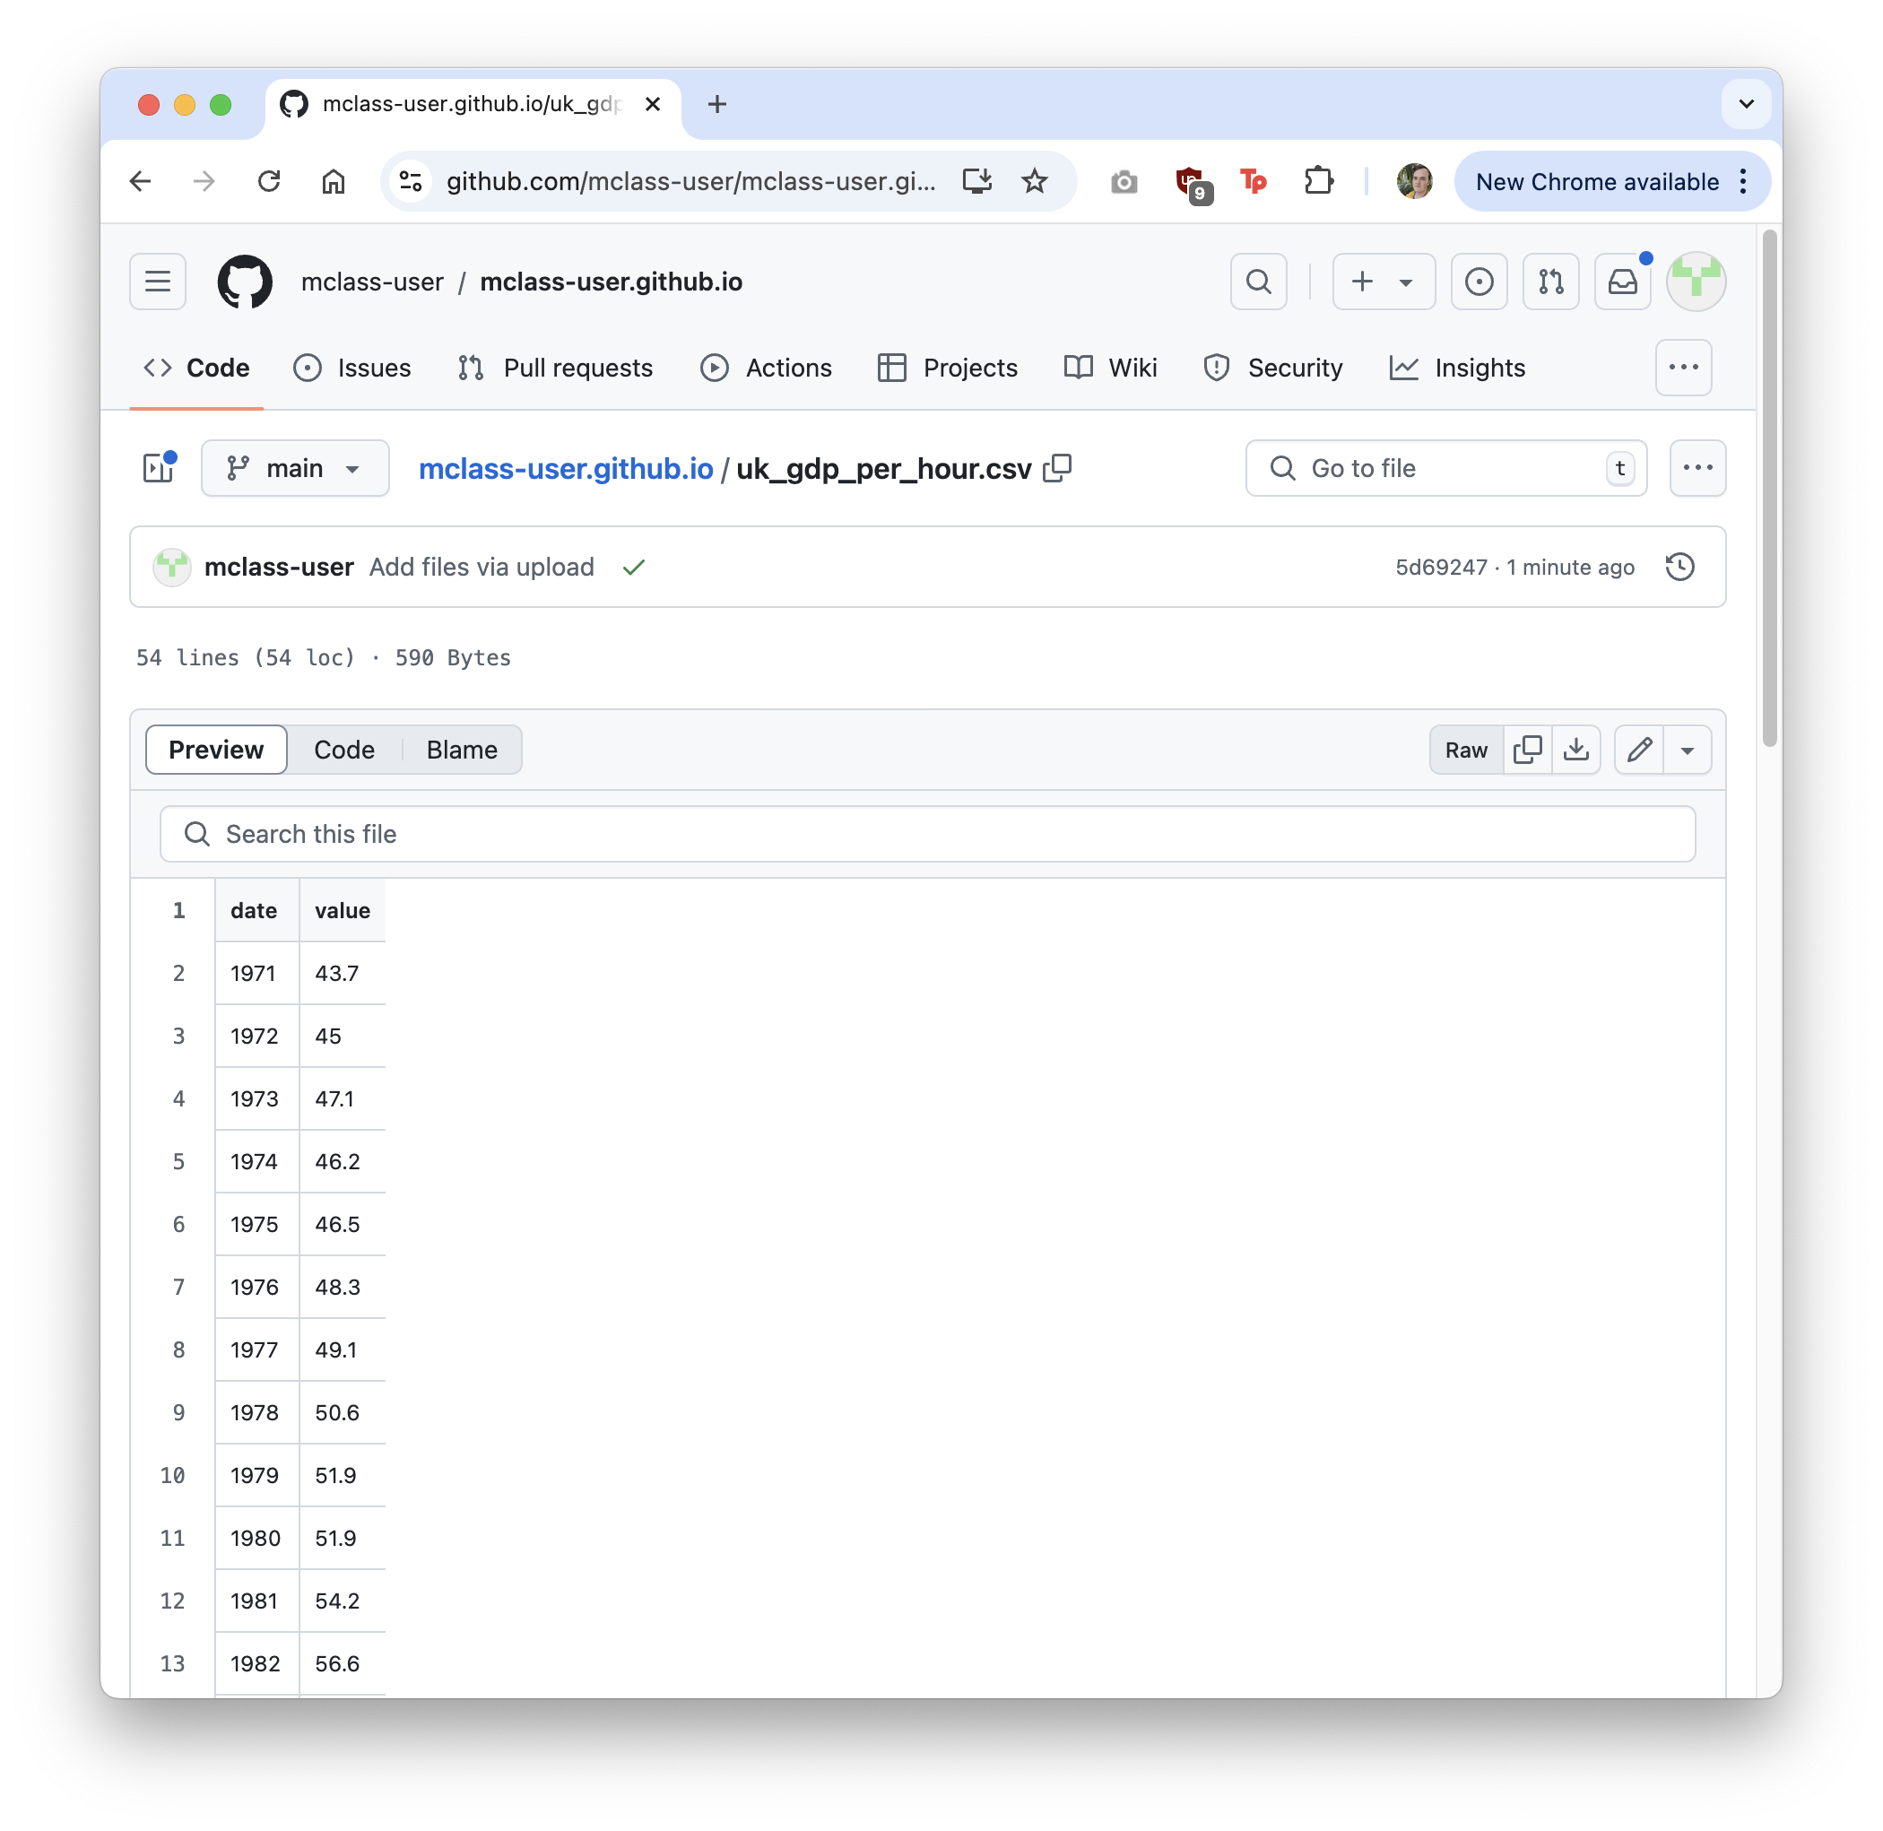
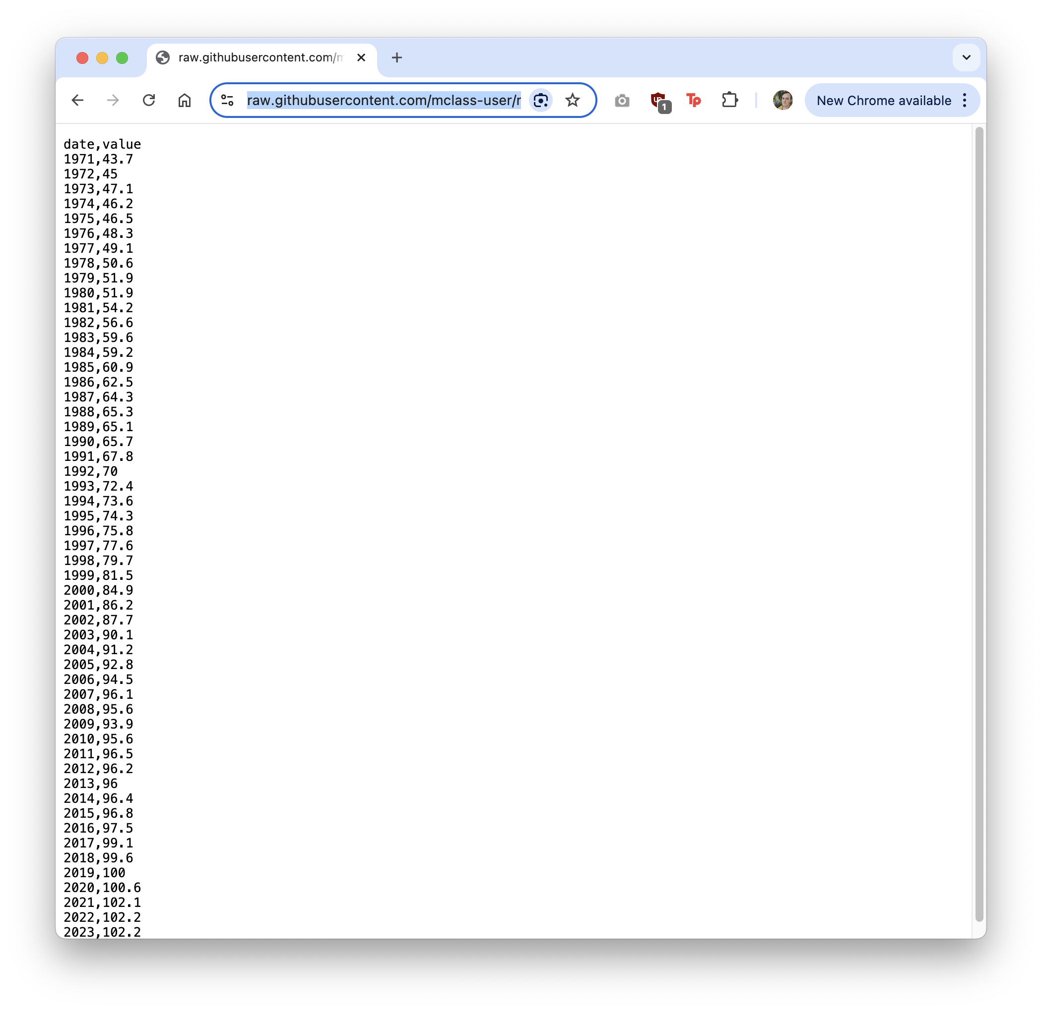
Uploading data.
We need the ‘Raw’ URL for our data.

Slide 56
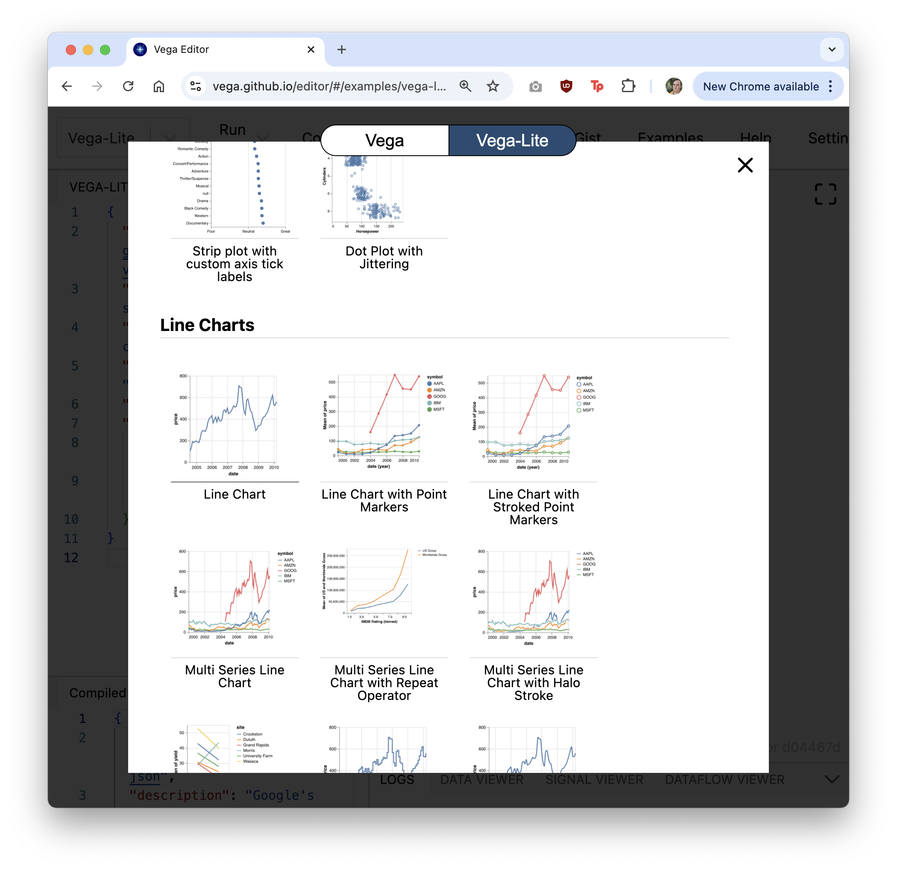
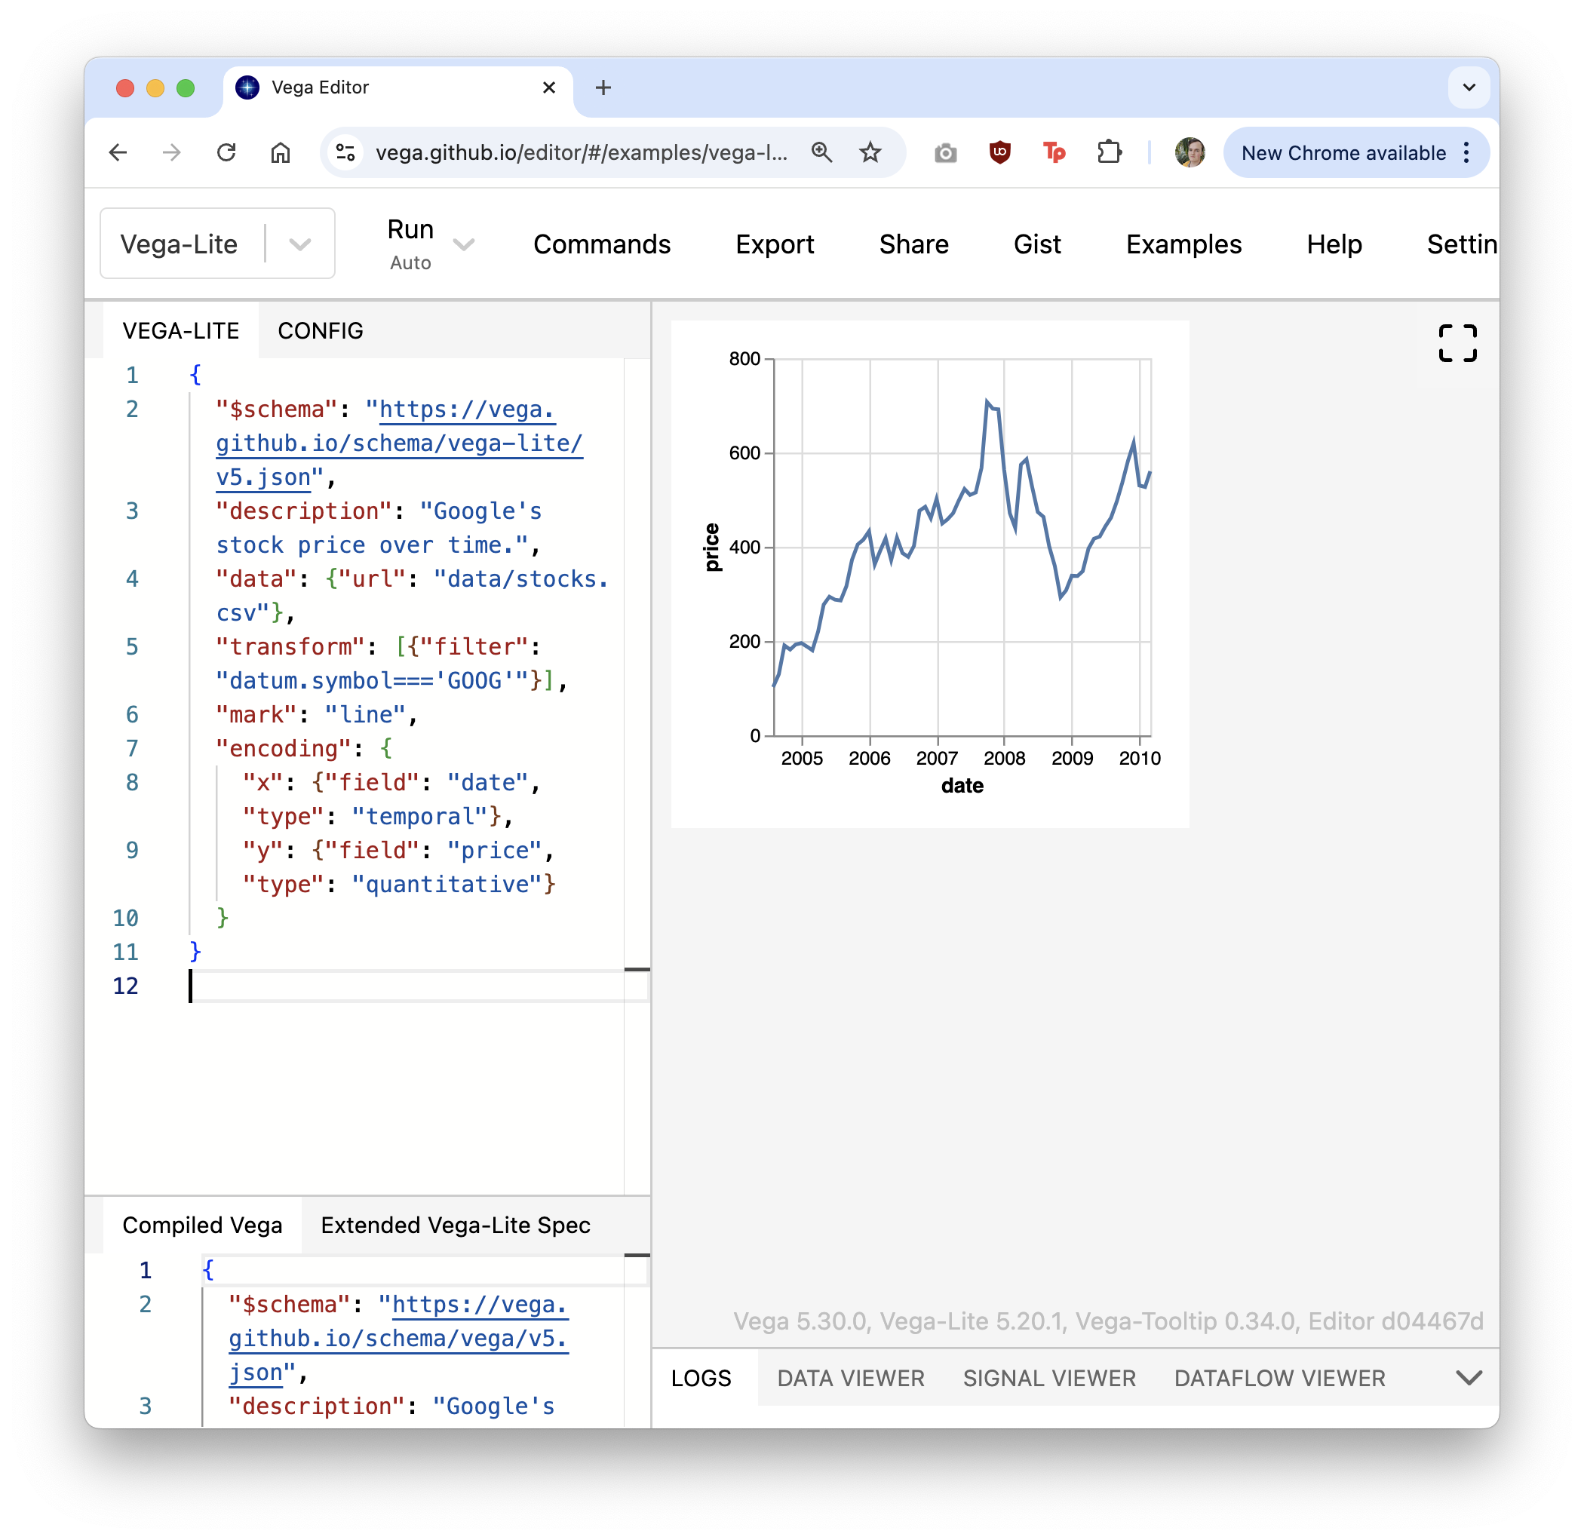
Adapting a Vega-lite Example.
We can start with an example chart.

Slide 57
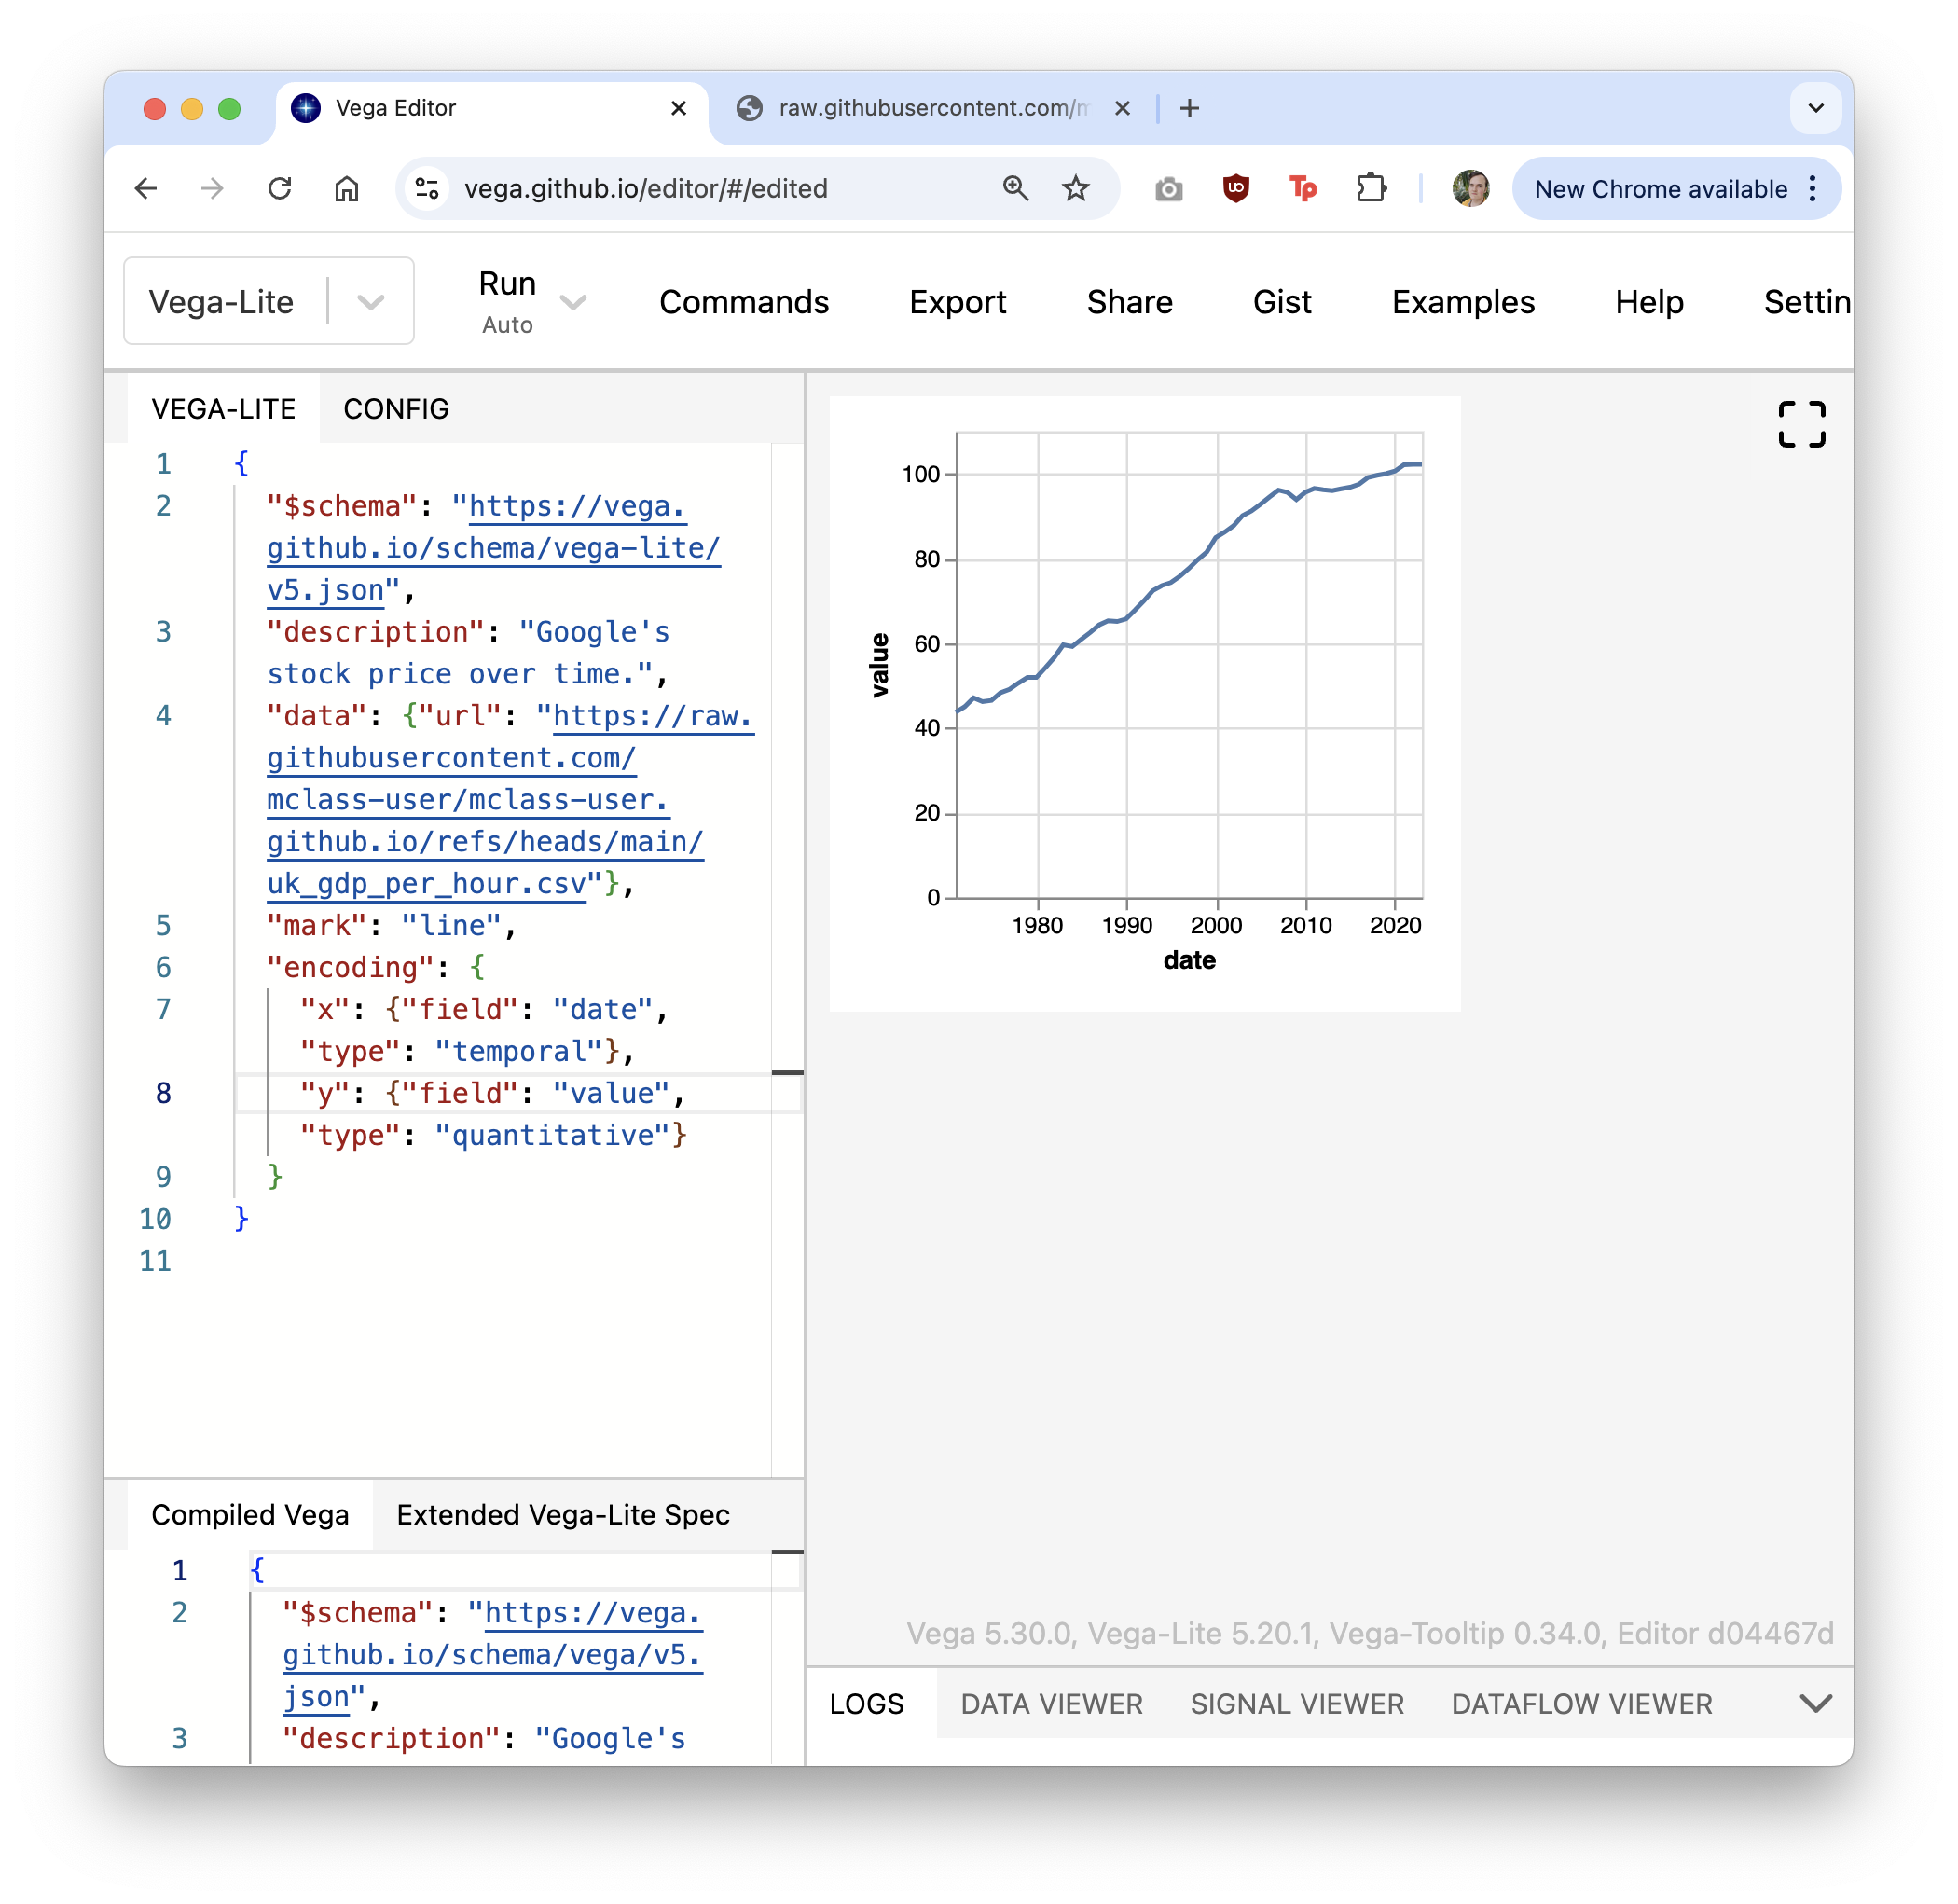
Adapting a Vega-lite Example.
We adapt it to our needs by changing fields.
Changing column names
Adding our Raw data link
Removing extraneous code

Slide 58
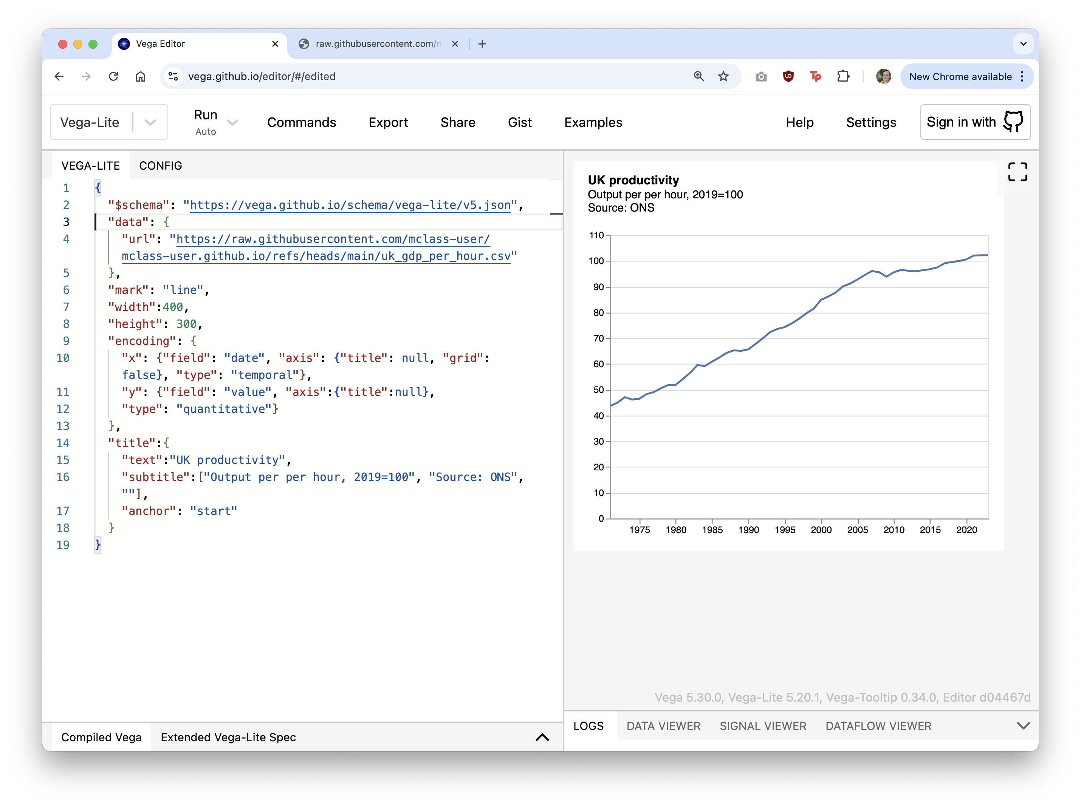
Adapting a Vega-lite Example.
The chart could do with work.
Let’s customise the axes and add a title.

Slide 59
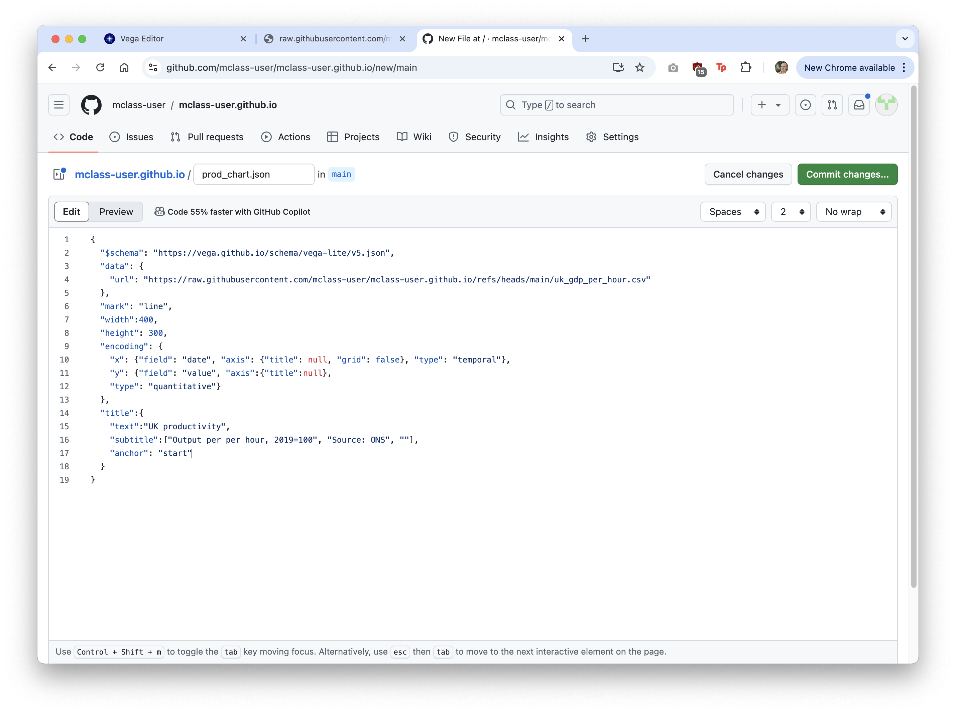
Uploading the chart.
Finally, we can add the finished chart to the repo.

Slide 60
Festival of Economics.
1-3 October 2024
Book talks, panels & live podcast recordings – your chance to ask experts from around the world the key economic questions of our time!
Scan for tickets and the programme.
With the election of a new government after 14 years, the theme of the Festival is looking back, to look forward:
Legacies of Empire, Inequalities, The Tyranny of Nostalgia, Sustainable Futures, Labour’s first 100 days, Building a fair society, Britain’s place in the world , Social mobility, The kids aren’t alright, UK productivity, Tim Harford podcast
… and more!
FREE TICKETS for:
- Legacies of Empire (Tues 1 October, 7pm)
- Inequalities (Thursday 3 Oct, 7pm)
in the Wills Memorial Building and are free to UoB students

